Slide 1
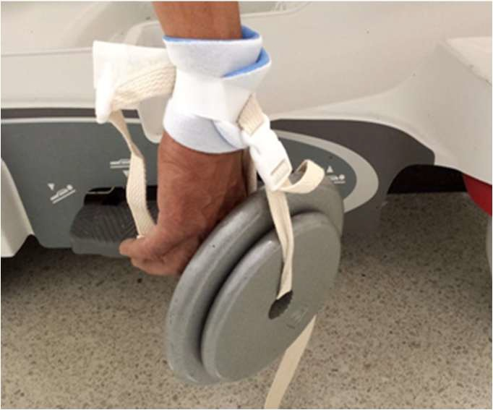
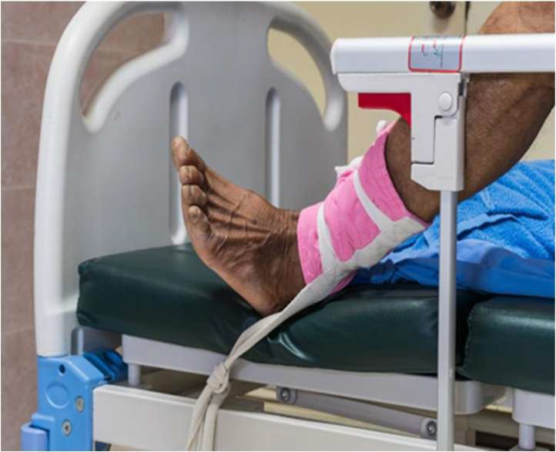
Restraints

Slide 2
Restraint Definition & Alternatives
Definition of Restraint
Restraint: Any manual method, physical device, material, or equipment that immobilizes or reduces the ability of a person to freely move their arms, legs, body, or head.
Use of Alternative Restraints
Restraint and seclusion are used to restrict movement during instances of aggression or to control problem behaviors, primarily for staff and patient safety.
Ethical concerns and potential harmful effects have led to a
reduction in restraint use, particularly in mental health settings.
Alternative approaches are now being incorporated to minimize restraint use in favor of safer, more humane methods.

Slide 3

Patient & Family rights regarding Restraint Use
Rights of Patients:
The Department of Health and Human Services outlines that restraint or
seclusion can only be used after less restrictive methods are ineffective.
Patients have the right to freedom from restraint/seclusion, and these measures should only be used when there is a threat to the safety of the patient or staff.

Slide 4
Preparing for Restraint Use
Psychological Adjustment:
Restraints require psychological adjustment for both the patient and family.
If restraints must be used, explain the following to the patient and family:
  The purpose of the restraints
  The expected care while restrained
  Precautions to avoid injury
  The temporary nature and protective aspects of restraints

Slide 5
Effects of using restraints
Negative Consequences:
Restraints can result in injury and death.
Physical Effects: Panic, fear, incontinence, infection, constipation, muscle atrophy, dehydration.
Emotional Effects: Loss of self-esteem, independence, dignity; anger, agitation, isolation, depression.
Other Effects: Pneumonia, strangulation, and falls
12
0

Slide 6
Alternatives to Using Restraints (1-6)
Prevention & Intervention Techniques:
Orient patients and families to their environment; explain all procedures and treatments.
Provide companionship and supervision with trained sitters or adjusted staffing.
Offer diversionary activities (e.g., music, objects to hold).
Place confused patients near the nurse's station for frequent observation.
Use calm, simple statements and physical cues as needed.
Apply de-escalation techniques, time-outs, and other verbal interventions for managing aggression.
12
1

Slide 7
Alternatives to Using Restraints (7-13)
Additional Strategies:
7. Provide visual/auditory stimuli (e.g., family pictures, clocks, radio).
8. Remove cues that promote leaving (e.g., elevators, stairs, street clothes).
9. Promote relaxation techniques and encourage normal sleep patterns.
10. Attend to patient needs: toileting, food, and fluid.
11. Camouflage IV lines with clothing or a dressing.
12. Evaluate medications and ensure effective pain management.
13. Reassess physical status and review relevant laboratory findings.
12
2

