Slide 1


Georgia Horizons
Taesha M Ward, MPA
Director of Program and Community Supports
Service Delivery & Administration
Notes:
Good afternoon everyone. My name is Taesha Ward, Director of Program and Community Supports with the Medical Assistance Plans Division at the Georgia Department of Community Health. Under my leadership is the Money Follows the Person, long term care services including Medicaid Home Health and Hospice and the four Medicaid Waiver programs. Today, we are going to dive deep into the Structured Family Caregiving service under the Elderly Disabled Waiver Program. This presentation aims to break down the rule into understandable components that every stakeholder in EDWP must know, understand, and operationalize. Compliance is required and will be monitored, so let's ensure we are all on the same page about what is expected and how to achieve it.“ The title of my presentation is Structured Family Caregiving: DCH Expectations

Slide 2

Our Purpose
Shaping the future of A Healthy Georgia by improving access and ensuring quality to strengthen the communities we serve.

Slide 3


Redefining the Medicaid Waiver Experience for Case Workers
November 2025
Prepared for
Notes:
Welcome
Introductions
Share our approach, and what we have developed for EDWP.
I’d love for this to be a discussion and learn about the problems you’d like to solve and what you envision for the future so we can address it in this meeting

Slide 4

Powering Case Management with Flexibility and Insight
Legacy case management systems often create barriers to efficiency, collaboration, and user satisfaction. Microsoft Power Platform enables us to break down those barriers with a connected, intuitive, and flexible platform that empowers staff, enhances the user experience, and adapts to future needs.
TODAY’S CHALLENGES
Siloed systems and manual workarounds
Outdated, non-intuitive user interfaces
Limited flexibility to adapt to policy or process changes
Minimal visibility into cases and performance
High maintenance costs and technical debt
​
An efficient, automated, and transparent case management system can enhance the accuracy of data and quality of service for individuals across Georgia.

Slide 5
Medical Assistance Plans Georgia Horizons

Slide 6

Transforming the Waiver Experience for Case Workers Supporting EDWP
How we’re doing this
We approach every endeavor with a human-centered design mindset, ensuring that solutions are built around the real needs of the people who will use them.
By combining empathy-driven research with technical expertise, we create systems that are intuitive, effective, and sustainable.
Our Process:
Discovery & Architecture
Design
Build
Test
Train
Go-Live & Support
We’re building a case management system, Georgia Horizons, leveraging Microsoft Power Platform to enhance automation, transparency, and the overall efficiency of the program. The current system, which relies on a legacy case management tool, requires numerous manual processes, leading to inefficiencies and friction.
Goals
Leverage Microsoft platforms and integrations for seamless experience and scalable architecture
Optimize and enforce case workflows based on policy and procedure
Provide a stable application leveraging cloud-based technologies
Enable agencies to make informed decisions by providing real time and near real time data and reporting
Improve service delivery through more accurate processing of their cases and incidents, leading to timely access to needed care and services
Automating lengthy processes reduces the burden of manual data entry and tracking
Active monitoring of nightly file Integrations with GAMMIS for prior authorizations, Medicaid status
Key Benefits
Automation + Efficiency
Transparency + Real-Time Data
User-Centered Design
Compliance + Security

Slide 7

Our Approach
4
Engaging with users helps identify what will make the new system successful as an MVP and beyond, as well as ensure potential risks are heard and understood.
We met with 16 AAA users and 36 CMA users to uncover challenges with current experience and workflows and opportunities for the future state. All users were asked to share hopes and needs for the new system, surfacing key themes and valuable insights.
DCH MAPS Sessions & Persona Workshop
6
10
AAA organizations Interviews
CMA organization Interviews
4 Key Themes from the User Interview Sessions:
Unreliable Data
System Performance
5 topics covered
Complex Navigation
Inefficient Communication
User Needs, Current Experience & Process, Challenges/Pain Points, Future State Opportunities, Requirements Gathering

Slide 8




Case Management User Insights
Paint Points – Current State
Unreliable Data
System Performance
Complex Navigation
Inefficient Communication
24hr delay on accurate data is lengthening task completion
Data discrepancies and validation requires frequent manual reconciliation, system integrations are desired
Data is not organized in an intuitive manner and by use case
Frequent system crashes lead to loss of data and the need to re-enter information
Slow loading times and performance issues cause frustration and delays, impacting user productivity and the quality of service for clients
Several external solutions exist for users to workaround WellSky
Users struggle to enter key data, perform assessments, and access key information
Best practices are not being used, such as: windows, and multiple clicks (steps) are required to perform simple tasks
Navigation and processes aren’t intuitive nor user-friendly without training and ongoing support
Lack of internal communication features within WellSky forces reliance on external emails, which is inefficient and difficult to track
Need for a better system to alert users, such as real-time updates and notifications about critical changes or statuses

Slide 9





High-level CCSP and SOURCE Functional Experience
Portal Login
Beneficiary Intake
Case Management
Incident Management
Dashboards
Single Sign On
Role-Based permissions
Reflect eligibility requirements for Medicaid and EDWP waiver
Update waiver waitlist upon determination of eligibility
Capture Level of Care documentation
Document Care Plan
System or administrative case routing (queues)
System routing based on business rules
Alerts and reminders
Supports audit logging and data tracking
Transmit key beneficiary and claims data to GAMMIS
Capture incidents and complaints tied to cases
Establish incident resolution workflow and audit logs
Reporting on incident cause and resolution data
Review case queues and eligibility waitlist
Assigned case dashboard/queue view for case workers/managers
Department leadership oversight dashboard of key metrics
Configure dashboards and reports as needed
Create Views

Slide 10

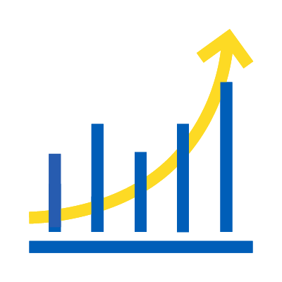


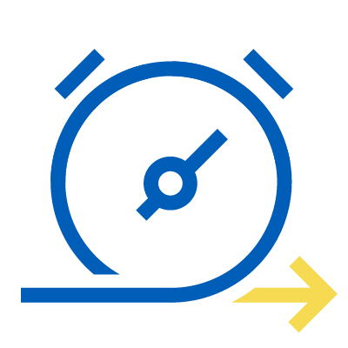

Transformation Benefits
Operational Efficiency
Scalability & Flexibility
Increased Transparency
Regulatory Compliance
By automating and redesigning workflows, Authorized User experiences improved productivity and streamlined operations, reducing administrative costs.
Scalable architecture allows for the seamless addition of new modules and functionalities as the program evolves, enabling long-term adaptability and resilience.
Real-time status updates and comprehensive reporting capabilities provide stakeholders with clear insights into case and incident progress and outcomes.
A modern system enables compliance with state and federal regulations, especially in managing health and personal information securely.
Empowering Georgians
A modernized case management system ensures applicants receive timely updates, clear guidance, and reliable service—making the Medicaid waiver process less stressful, more predictable, and supportive of better health and wellbeing outcomes.
Enhanced Data Management
Reduced Workload & Faster Turnaround
Proactive Incident Management
Improved data accuracy and integrity enable users to make informed decisions and policy adjustments.
Automation alleviates the burden of manual data entry and tracking, enabling staff to focus on patient care.
Enhanced tracking and reporting enable swift issue response, minimizing disruptions to service delivery.

Slide 11
Timeline
Georgia Horizons will be operational for CCSP and SOURCE programs by end of SFY 2026
Illustrative. Timeline not to scale.
Functional Development Complete
User Acceptance Testing
Wave 1
User Acceptance Testing
Wave 2
End User Training
WellSky and GAMMIS Member and Provider File Transmission Testing
GAMMIS Service Order and Authorization File Transmission Testing
Go-Live

Slide 12

What does this mean for you?
CMA will submit all service orders through Georgia Horizons
Nightly data file transmissions will be sent and received from GAMMIS
Medicaid Eligibility, Service Authorizations in GAMMIS will be reflected in Georgia Horizons
Standardization of process and documentation for all CCSP and SOURCE
Transparency of data
Proactive identification of Training Needs

Slide 13
Thank you.

Slide 14
Appendix

Slide 15
The VISION
To develop an efficient, automated, and transparent case management system that enhances the accuracy of data and quality of service for elderly and disabled individuals in Georgia.

Slide 16
Executive Summary
User discovery sessions with AAA and CMAs revealed a critical need for enhanced data entry, system reliability, user friendliness, and trust.
AAA & CMA users have developed their own mechanisms to help navigate the current system's limitations to complete daily tasks to ensure Members (clients) receive their care.
Both user groups feel WellSky is unreliable and unintuitive, expressing excitement to be included in development of a new system. All parties are willing to test and validate future efforts. | With limitations of WellSky, both user groups have been able to supplement daily tasks with workaround solutions—using whiteboards, notes, paper referrals, excel sheets, SharePoint sites.

Slide 17

Establish Client Data as Source of Truth
Unreliable Data
Does not increase our efficiency or organization in daily workflows. We need ease, efficiency, reliability.
The current experience is not seen as reliable and fails to foster confidence among users who need accurate data for their daily tasks—resulting in duplicative efforts, such as: data re-entry, and data validation within other systems.
Key Observations
Client record information is 24hrs behind and lengthens the process of executing tasks
Difficulty in finding client records due to multiple duplicate records and inefficient search functionalities
Essential data points are missing from Wellsky and need to be validated and searched for in other systems
Difficult to sort existing data and analyze it, also generating reports is a pain point

Slide 18
Modernize the System Performance and Functionality
System performance
Members get frustrated waiting so long, an average 15-20 minutes, due to loading issues. Leads to follow-ups
It became clear that the current interface does not serve the user’s needs, and the workflow and process is cumbersome.
Key Observations
Frequent system time outs, long loading times, and system crashes occur
Users are required to manual save frequently during assessment intakes
Difficult to upload documents and generate relevant reports successfully, complicated process
Users desire a more streamlined and automated system to reduce duplicated efforts and errors, such as: electronic signatures, document generation, off-line data collection
Need for better-defined user roles and permissions to prevent unauthorized access and errors

Slide 19
Create a Seamless, Frictionless Path with Wayfinding Cues
Complex Navigation
The interface can be complex and not always intuitive, which makes it challenging to locate specific features and complete tasks efficiently.
The current experience is seen as an obstacle rather than a tool and fails to foster autonomy among users who expect intuitive navigation, reduced steps, improved data entry experience, and robust search functionality —resulting in user’s needing to create and maintain external workaround solutions.
Key Observations
System’s UI is outdated and does not follow accessibility best practices nor WCAG standards
Users lose their way when navigating between windows
Users have a hard time locating key information
The information architecture is not intuitive and doesn’t consider the user’s process flow
Developing their own system trainings, documentation due to outdated manuals

Slide 20
Streamline Communication and Collaboration Between Users
Inefficient Communication
We need to be able to communicate with others through the program.
Many interview sessions highlighted the desire for more streamlined communication features within the system that enabled efficient collaboration between various users—including alerts, notifications, automated email updates, error messages, tooltips, internal messaging, CMA availability, record update history.
Key Communication Observations
Alerts are not reaching users at all or in timely manner, forcing users to duplicate the message outside the system as an email
Users are burdened with managing multiple external communication threads
Users want to be able to notify each other with availability, updates, record status changes, assignments within system

Slide 21
Core Capabilities
Email and In-App Notifications
Role Based Access Control (RBAC)
Task Assignment and Tracking
Workflows and Business Process Flows
Messages and Alerts sent to a user's registered email address to inform them of important events (e.g., task assignments, status changes, deadlines, approvals).
Permissions are granted according to a user’s role, ensuring that users only access data and features relevant to their responsibilities.
Users can delegate tasks to individuals or teams, specifying details like deadlines, priority, and instructions.
Guides users through stages of case resolution with defined steps and actions.
Dashboards and Charts
Views and Filters
Activity Timeline
Form Customization
Real-time data visualization for monitoring workload (This is separate from power BI).
Customizable system and personal views to organize and segment data.
Unified view of all activities (emails, notes, calls, appointments) related to a record.
Show/hide fields or tabs based on field values or roles to enforce business logic.

Slide 22




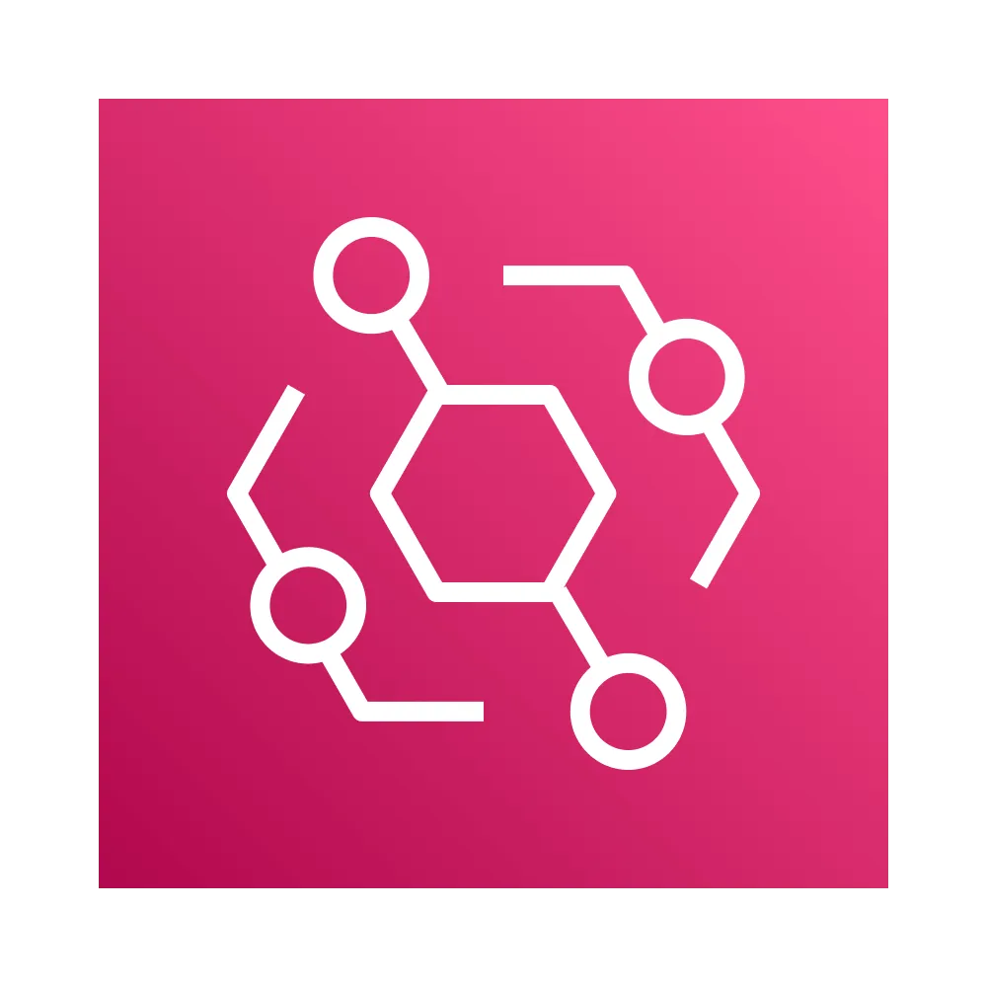


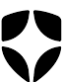


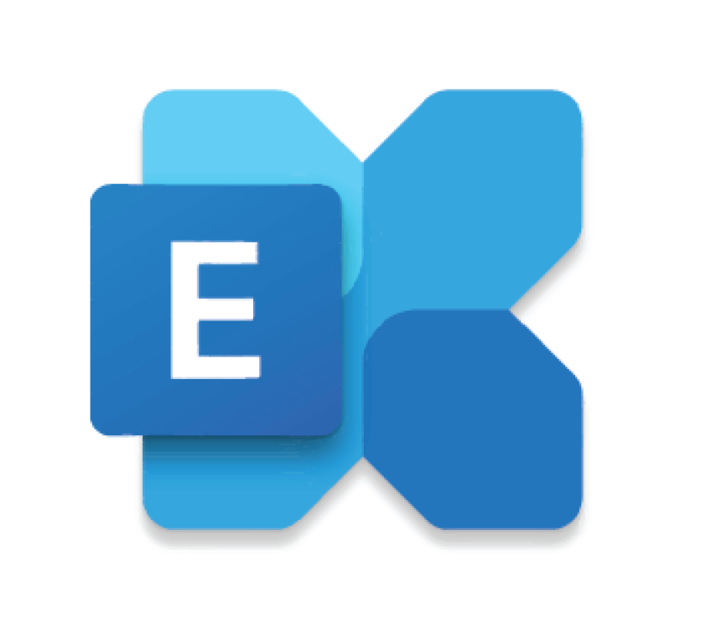
EDWP Technical Solutions
User interface
Data Management
Workflow Automation
Power Apps – Model Driven App
Dataverse
Power Automate
Internal app for case managers and administrators for operational workflows.
Optimized and ADA-compliant mobile access for case mgrs. and geographically distributed users.
Dataverse: Operational data store for active case management workflows, incident tracking, and live reporting.
Automates processes for case intake, incident resolution, and care coordination
Sends alerts for deadlines, approvals, and updates.
Integrations
Workflow Automation
Role-Based Access
Lambda, AWS, MuleSoft
Power Automate
Auth0 and External Entra ID
GAMMIS Integration: batch processing of Medicaid data using SFTP for service authorizations, billing, and reporting
Automates processes for case intake, incident resolution, and care coordination
Sends alerts for deadlines, approvals, and updates.
USER INTERACTION & SUPPORT
DATA MANAGEMENT AND INTEGRATION
AUTOMATION & INTELLIGENCE
Auth0 as IDP and mirrored external account in Entra
Mobile ready
Power Apps
DOCUMENT Management
Mobile offline profiles
Laserfiche
Stores all documents
Retrieves them as downloads in the browser when prompted
EMAIL NOTIFICATION
Shared Mailboxes
Created in Exchange Online and connected to each environment

