Slide 1



Let’s Talk About
Loneliness, Isolation & Depression
Presented by AmeriCorps Seniors
Metro Atlanta RSVP
A Program of the Atlanta Regional Commission

Slide 2

Let’s Talk: Presentation Goals
This presentation will help you understand:
How loneliness, isolation, and depression can affect your health
The connections between them
The risks associated with them
That they are not a NORMAL part of Aging!
Learn techniques to help yourself and others experiencing these conditions.
Share resources to help address their negative impact.

Slide 3
Let’s Talk: Good Mental Health
Mental health is essential to good health.
Mental health is very important to our personal well-being, our family, and our personal relationships.
Good mental health is successful mental functioning that results in productive activities, fulfilling relationships, and the ability to cope and adapt.
It includes emotional balance, the ability to live fully, and the flexibility to deal with life’s inevitable stresses, challenges and traumas.

Slide 4
Definitions

Slide 5
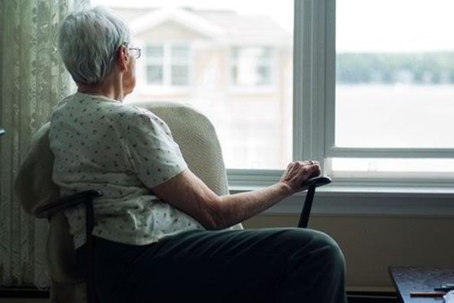
Loneliness
Having fewer social contacts and meaningful contacts and/or meaningful relationships that one would like to have

Slide 6

Social Isolation
Problems that occur in an individual’s social network, community or society that result in a person losing a sense of belonging

Slide 7
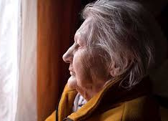
Depression
A mental health/medical condition that creates a sad mood which lasts for a long time and interferes with normal functioning

Slide 8

Loneliness, Isolation and depression are NOT a NORMAL part of Aging!

Slide 9

Loneliness
Loneliness is a growing health epidemic!
“We live in the most technologically connected age in the history of civilization, yet rates of loneliness have doubled since the 1980s.”
Dr. Vivek Murthy
Former U.S. Surgeon General, 2017

Slide 10

Let’s Talk: Loneliness
Is the psychic pain and distress that happens when you feel alone
Is possible even when you are around other people
Is usually related to the quality of our relationships
Can be “passed on” to others
Can be caused by lack of physical activity.

Slide 11
Older Adults, Isolation and Depression
Many older adults go through major life changes that make them more vulnerable to isolation and depression.
Aging may bring changes to social relationships, and readjustment can be difficult.
A major risk factor for isolation is loss of a spouse/loved one.

Slide 12
Factors
Associated with
Isolation
Loss of a spouse/partner
Living alone
Mobility or sensory impairments
Major life transitions or losses
Low income/limited financial resources
Being a caregiver for someone with a serious condition
Psychological or cognitive challenges
Inadequate social support
Rural/unsafe/inaccessible neighborhood
Transportation access challenges
Language barriers
Racial/ethnic/sexual orientation and/gender identity issues

Slide 13
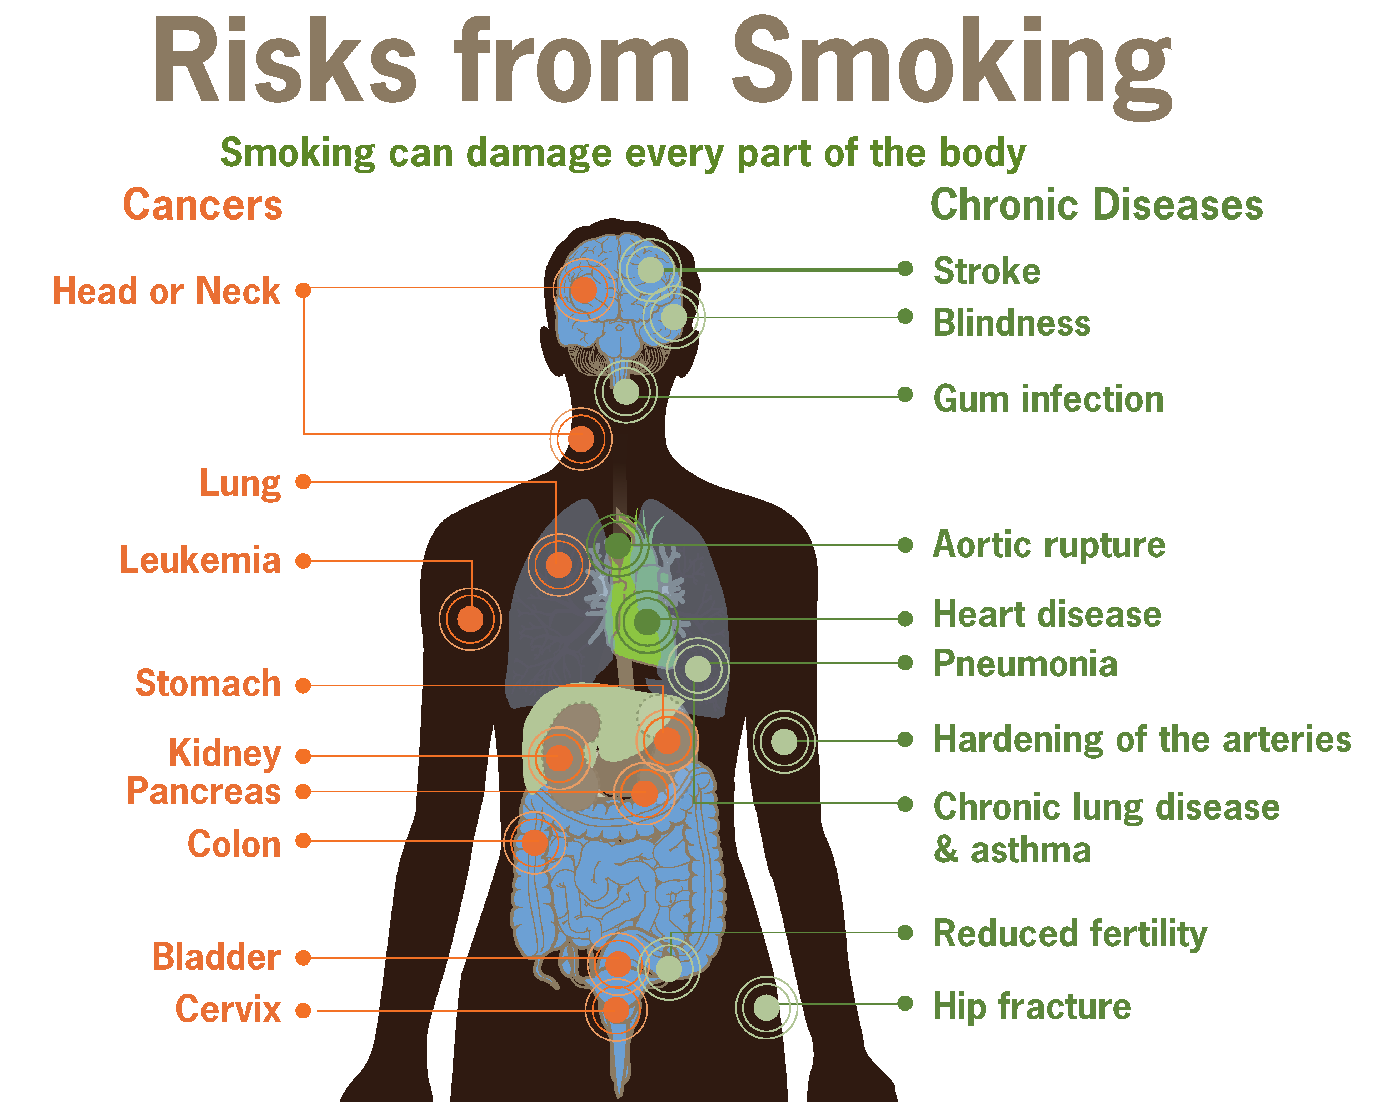
What Research
Tells Us
More than 8,000,000 adults aged 50 and older are affected by isolation.
The health risks associated with prolonged isolation are equivalent to smoking 15 cigarettes a day!

Slide 14
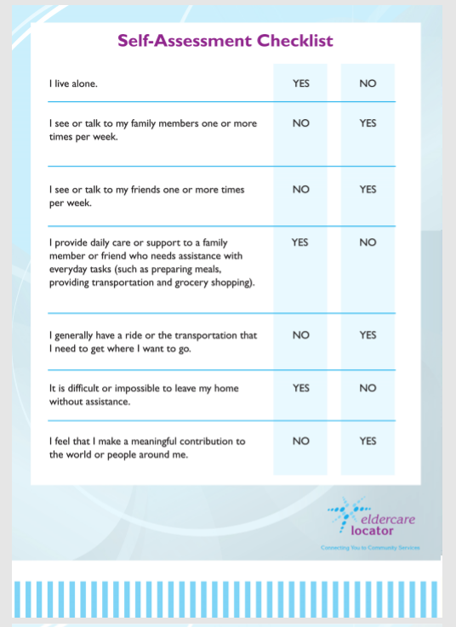
Self-Assessment Checklist
Self-Assessment Checklist
Do you have risk factors for depression?

Slide 15
Lonely/Isolated Now?
Stay Connected and Engaged
Take stock of your networks and activities to evaluate what you can do to make more connections.
Notice if it takes more effort to stay connected.
Nurture and strengthen existing relationships.
Stay physically active and include group exercise.
Volunteer.

Slide 16
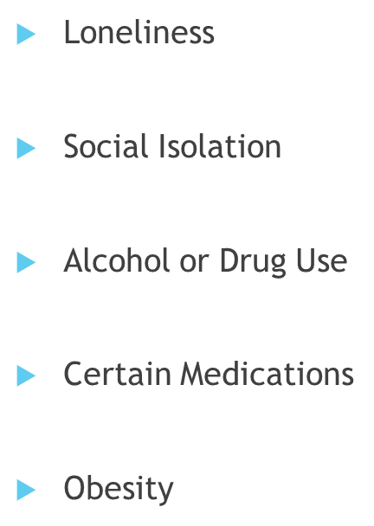
Let’s Talk: Depression
Factors
Associated
with
Depression

Slide 17

Depression:
Health Risks
Untreated depression is associated with:
Higher risk of death
Heart Disease
Stroke
Cancer
Diabetes
Alzheimer’s Disease and other forms of dementia
Suicide
Insomnia
Rapid weight change

Slide 18
Depression Warning Signs
Little interest or pleasure in doing things
Feeling down, depressed or hopeless
Trouble falling or staying asleep
Feeling tired or having little energy
Poor appetite or over-eating
Feeling bad about yourself
Trouble concentrating on things
Moving or talking so slowly that others now notice
Thoughts that you would be better off dead

Slide 19
Depression and Suicide
Older adults with depression are at risk for suicide.
If you are thinking about harming yourself or attempting suicide, tell someone who can help immediately.
Call your doctor.
Call 911 for emergency services.
Call the nearest hospital emergency room.
Call the toll-free, 24-hour hotline of the National Suicide Prevention Lifeline at 800-273-TALK (800-273-8255); TTY: 800-799-4TTY (4889).

Slide 20
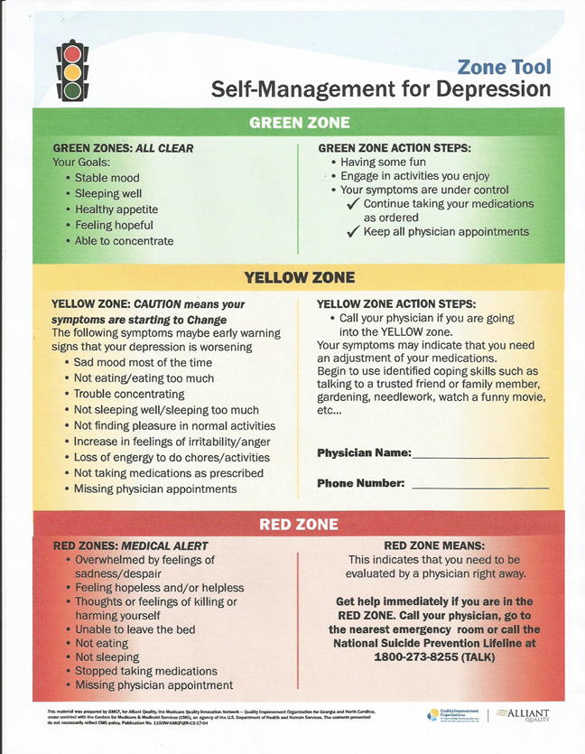
Self-Management Tool

Slide 21
Feeling L-SI-D: What are The Options?
See a doctor
See a therapist
Seek Resources
Stop smoking
Reach out to a friend
Practice mindfulness

Slide 22
Feeling L-SI-D: What are The Options?
See a doctor: a doctor can diagnose depression and offer a care plan that fits you and your illness.
See a therapist: After diagnosis, your doctor may recommend counseling with a judgement-free counselor who will help you cope with feelings you are not sure how to manage.
Seek Resources: Reach out to local agencies for resources to help with symptoms of isolation and depression (Resource List provided).
Stop smoking: Smoking is highly correlated with mental health conditions, including depression.
Reach out to a friend: Meaningful human interaction can combat loneliness.
Practice Mindfulness: Alternative practices -- such as relaxation techniques, meditation, and acupuncture – may help reduce symptoms of depression.

Slide 23
L-SI-D: Key Notes and Takeaways
Wellness and recovery are possible.
No matter how long a person experiences symptoms of loneliness, social isolation or depression, people can and often do recover.
There are all kinds of interventions, treatments and supports available to help.
You are the key. Take responsibility for you!

Slide 24
Resources
Georgia Crisis & Access Line www.mygcal.com 800-715-4225
National Suicide Prevention Hotline 800-273-Talk
Emergency/Fire/Police 9-1-1
Veterans Crisis Line 800-273-8255
Fuqua Center for Late Life Depression 404-778-5526
SAMSHA Treatment Locator Line 800-662-4357
GeorgiaCares (for Medicare answers) 866-552-4464
Empowerline www.empowerline.org 404-463-3333

Slide 25



Thank you for participating.
For questions regarding this presentation, email volunteer@atlantaregional.org
To learn more about Aging Well visit www.Empowerline.org
To find additional events visit www.Empowerline.org/events
To become a volunteer, visit www.Empowerline.org/volunteer

